Slide 1
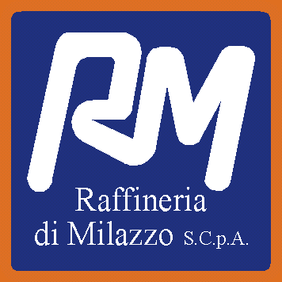
Raffineria di Milazzo
Shutdown Turnaround & Inspection forum
A FOCUS ON SHUTDOWN PLANNING AND EXECUTION
Amsterdam 21-22-23 May 2023
Giuseppe Chiofalo

Slide 2
Summary
Shutdown Planning And Execution
Milazzo Refinery, an overview
Asset Integrity: key aspects
Asset integrity: critical asset ICE selection
Challenges for successfully shutdown
Inspection Plan
How to planning a STO
Case study of reliability improvements

Slide 3
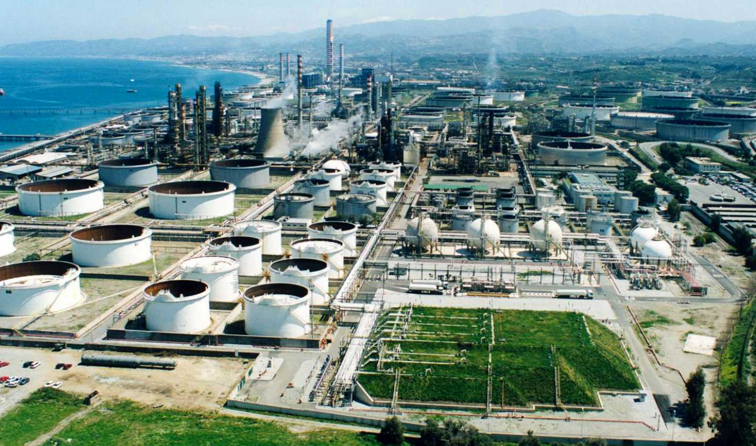
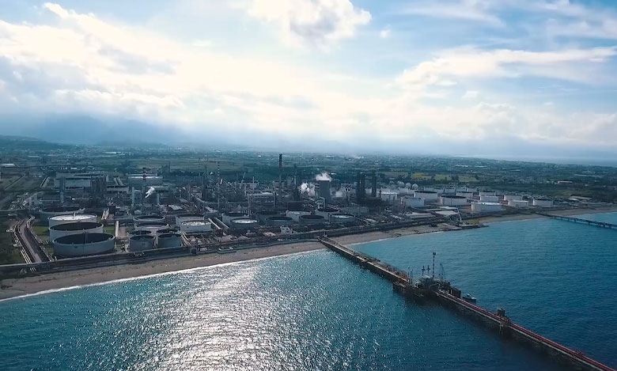
MILAZZO Refinery, an overview
Supplier for nearly 20% amount of National fuel needs

Slide 4
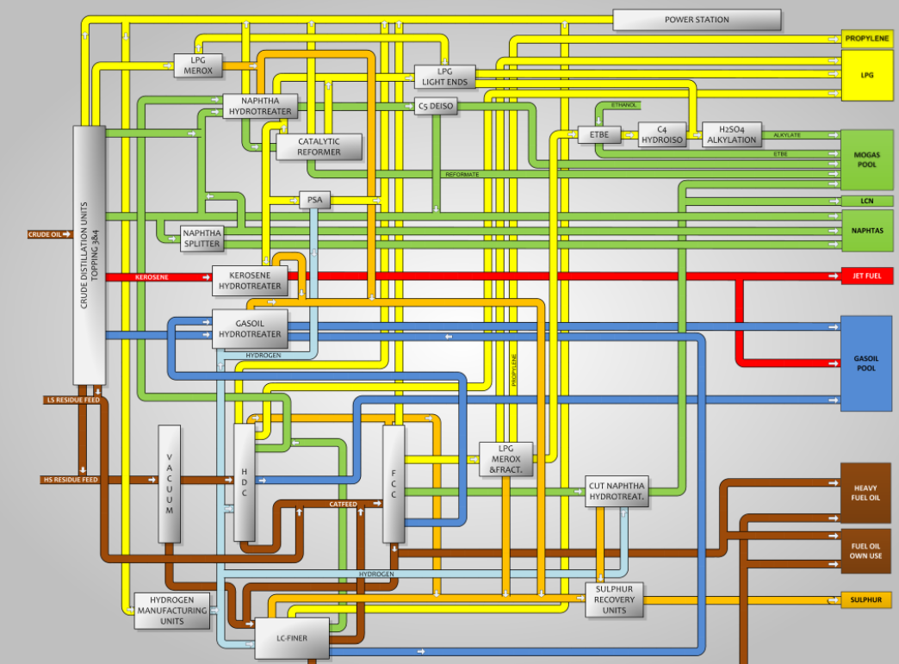
MILAZZO Refinery, an overview

Slide 5
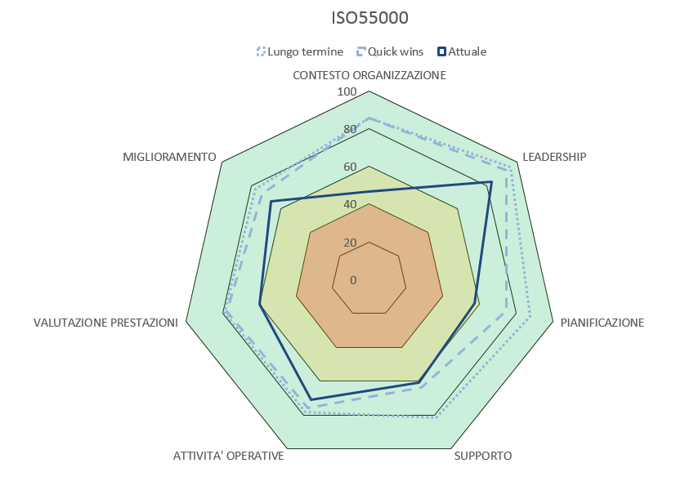
Asset Integrity- key aspects
Key aspects of Asset Integrity are summarize in the international standards:
ISO 55000 Std: Asset management — Overview, principles and terminology
Thematic area and evaluation point to gain standard compliance are summarized as follow:
Context of the organization
Leadership
Planning
Support
Operation
performance evaluation
improvement
Therefore, an acceptable Asset Integrity level is the result of the overall organization of an industrial site (refinery, extraction wheel, power generation plant, etc. )

Slide 6
Asset Integrity- key aspects
RISK REGISTER. Critical Item selection
Thematic area for Asset Integrity ISO 550000, where Maintenance Engineering divisions are more involved is PLANNING activities (maintenance, inspection, FFS, etc.).
A basic step is risk register definition, which require a preliminary Asset Register availability.
Risk Register is the amount of item with Integrity Relevance In case of failure. According to consequence are classified as follow:
SCE- Safety Critical Elements
OCE-Operating Critical Elements
ECE- Environmental Critical Elements
We all dream a safety and environmental friendly production site, but is also required an operation availability and business sustainability, therefore also OCE integrity management is very important, even if a more internal issue

Slide 7
Asset Integrity- key aspects
SCE- Safety Critical Elements
In Italy, as well in EU countries, definition of SCE comes from mandatory recommendations of the European Directive 2018/18/UE, also knew as Seveso III.
SCE are items directly involved in relevant incidental event, as reported in the Safety Report, where possible scenario are evaluated in terms of consequence and mitigation action.
SCE list may include:
Pressure equipment or atmospheric tanks
Process line or pipe-line for fluid transportation
Rotation machines: pumps, compressors, turbine, etc.
Regulation or Interlock valves, including Emergency Interlock valves
Process instruments (switch or analogic involved in Emergency Shut Down sequence)

Slide 8
Asset Integrity- key aspects
SCE- Ageing and life cycle evaluation
As SCE are directly involved in relevant incident with consequence that also are spread outside the area of production site, it is very important Ageing Management of these element, especially for ones subjected to time related damages mechanisms (static equipment and machines)
…An experimental approach recently applied in Italy
This methodology consists in a Bayesian approach resulting in a comparative methodology- fish bone model:
n. 6 ageing promoter parameters
n. 6 ageing restraining parameters
Algebraic sum gives a numeric parameter of ageing level of single Unit or production site:
>0 ageing well managed, <0 corrective implementations are required)

Slide 9
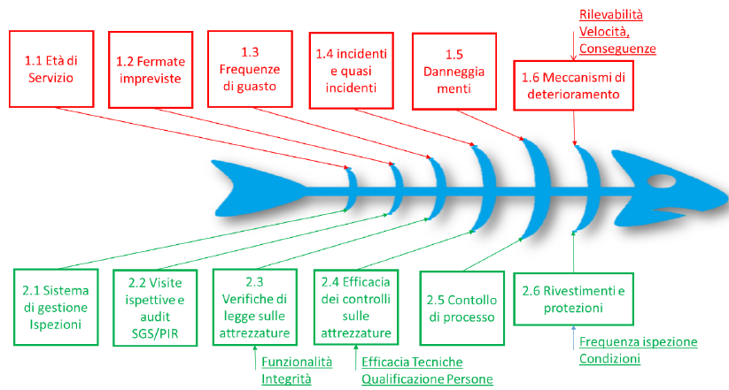
Asset Integrity- key aspects
Ageing management – Index methodology
Parameter object of evaluation
Service life
Unplanned shut-down/Up set
Failure frequency
Incidents and near miss
Number of failure
Damages mechanism Damages
Inspection Management (RBI, IOWs, etc.
Authorities auditing findings (SGS-PIR)*
Mandatory Inspection on PED eq.
Effectiveness of NDT and Inspection
Process Control systems (ESD, DCS, etc.)
Lining and protections against corrosion
* Auditing activities from external authorities carried put on “Seveso”sites

Slide 10

Challenges for successfully shutdown
When a successful MTA?
No incidents or workers injuries
Planned activities completed within scheduled programme
Good reaction to inspection findings (unplanned)
Budget respected
A….MISSION IMPOSSIBLE?

Slide 11
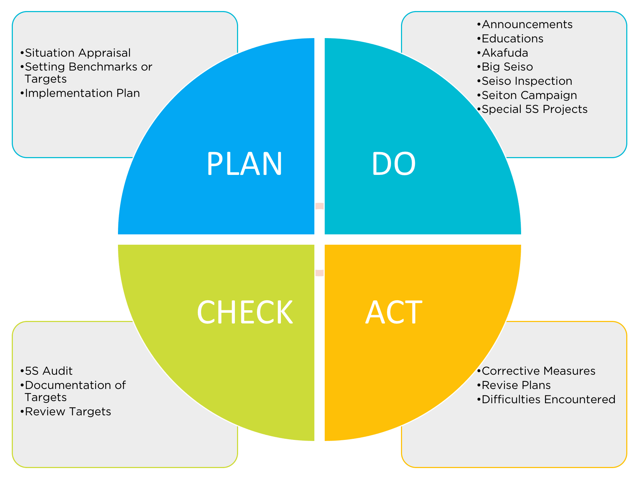
Challenges for successfully shutdown
CHALLENGES FOR SUCCESSFULLY SHUTDOWN
planning
Inspection strategy
Previous MTA inspection findings elaboration
Good Scheduling for equipment replacement and spare parts supply
Technical requirements evaluation of contractors
Improvements (process and mechanical engineering)
execution
Detailed time programme
Critical paths
Inspection conclusion dead line
Progress Monitoring (daily report)
….well summarized by a Deming cycle for process control

Slide 12
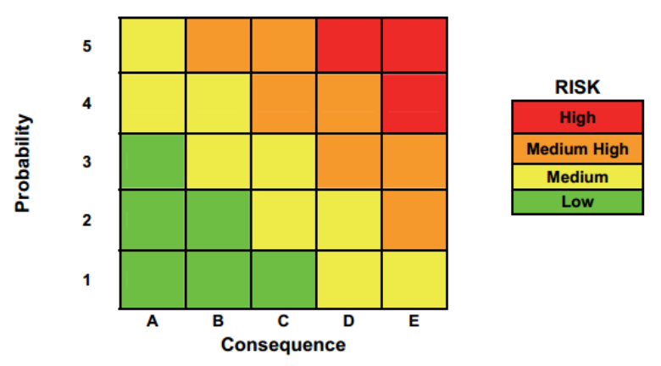
Challenges for successfully shutdown
INSPECTION STRATEGY
…a focus on static equipment (pipes, vessel, exchanges, reactors, etc.)
RBI methodology
Planning Inspection (on service or during shoot down)
Interpretation of inspection results (remaining life, FFS, etc.)
Dynamic evaluation (IOWs API 584).
RBI methodology allows a good inspection management as efforts are focussed to mast risk related equipment, saving time and money

Slide 13
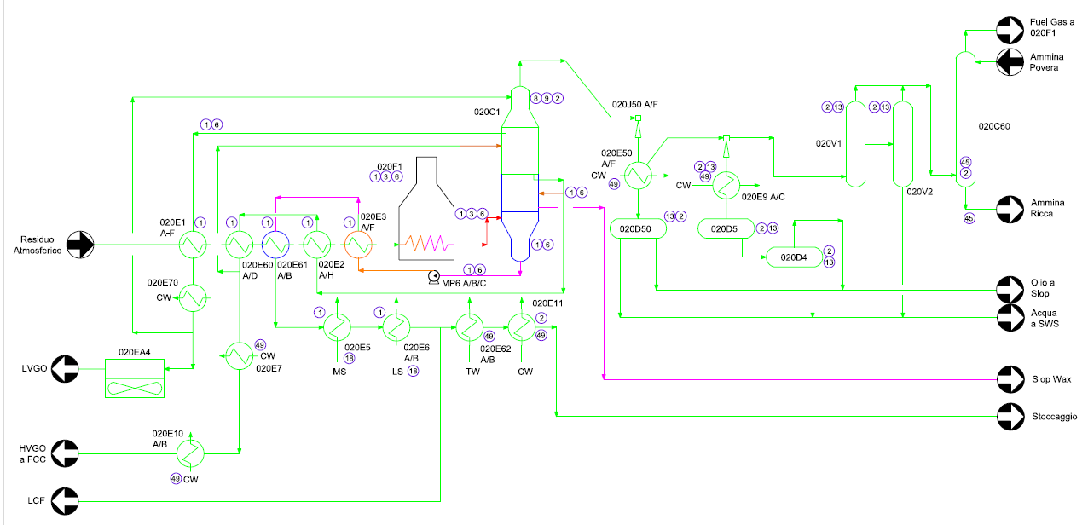
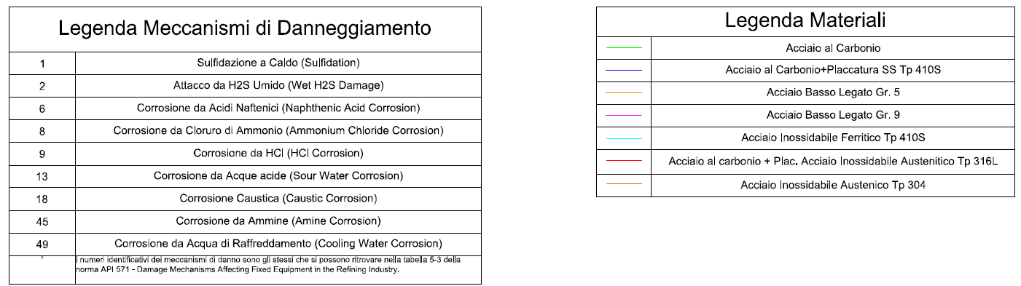
Challenges for successfully shutdown
INSPECTION STRATEGY- RBI
Damages mechanism summary and material diagram for vacuum unit

Slide 14
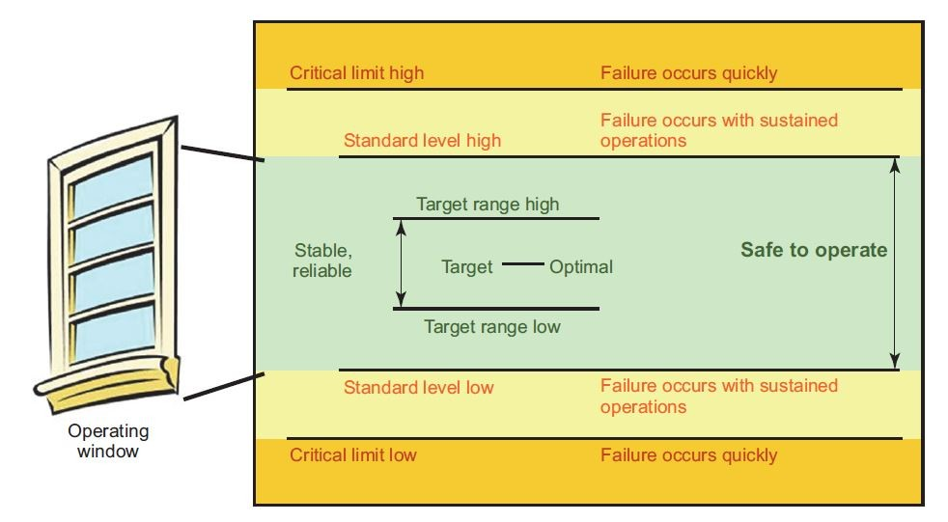
Challenges for successfully shutdown
INSPECTION STRATEGY- Integrity Operating Windows
Data Recovery
(PFD, P&Id, op. manual, RBI)
Corrosion Loop Identification
IOW limits
identification
IOW limits
monitoring
IOWs monitoring may drive inspection plan to be up-graded, or, at least MTA scheduling

Slide 15
Challenges for successfully shutdown
PLANNING TURNAROUND
Pre-STO inspection organization (up-grade insp. Plan)
Inspection preparation (scaffolding, insulation removing, etc.)
Previous MTA findings follow-up
Scheduling procurement for equipment replacement and spare parts supply
Contractors selection and commercial agreement
Pre-fabrication activities

Slide 16
Challenges for successfully shutdown
PLANNING NEXT TURNAROUND

Slide 17
Challenges for successfully shutdown
IMPROVEMENT AND REVAMPING ACTIVITIES
Frequently MTA not only for inspection and pure maintenance activities, but also capital project may be carried out.
In the worst cases revamping and MTA are done in the same time!
… a smart planning is more and more necessary:
Maintenance and capital project can be head to different division
Job list must include both maintenance and revamping activities!
Good communication is strategic for success!
Maintenance and project are often very closely, some times on the same item. The same managing during the execution is required.
Well planned improvement project allows saving time…and in the must of case saving of money

Slide 18
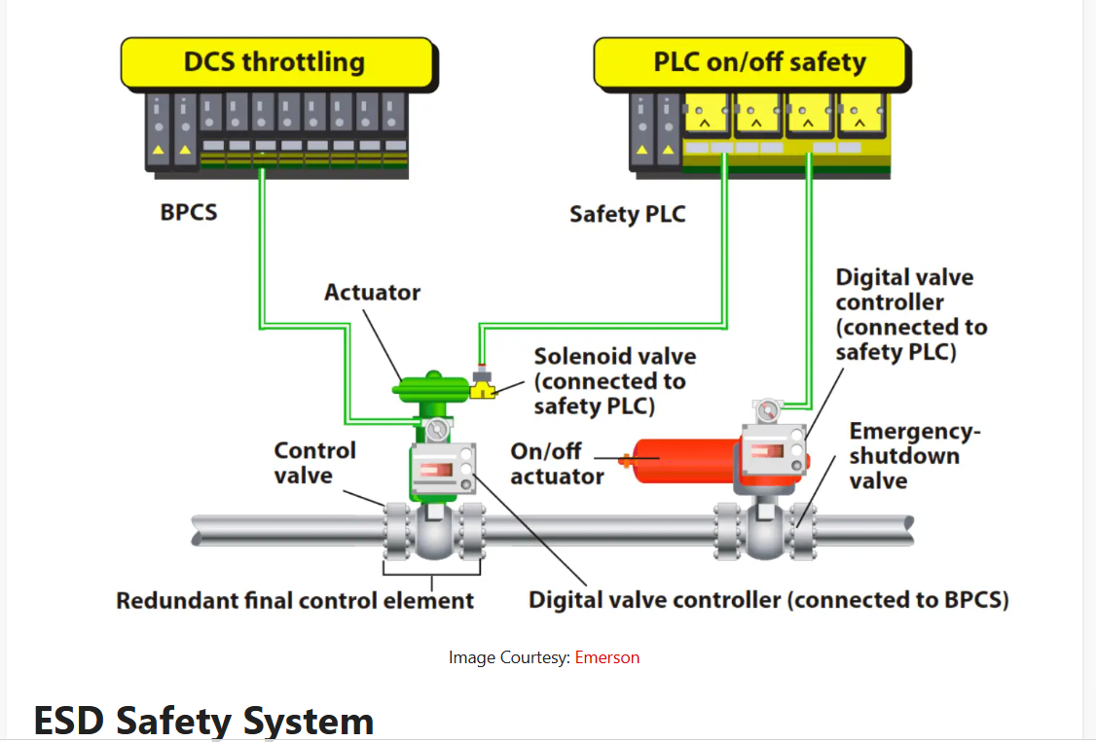
Challenges for successfully shutdown
SOME OTHERS ASSET INTEGRITY IMPACT ON STO JOB-LIST
Not Only static equipment experience inspection and maintenance activities.
Also process instruments, such as CRITICAL control valves or trasducers are undergone to maintenance, check or tests
Loop-check and EIV tests are carried out before star-up
All critical transducers or switch are tested before start-up, as well the good functionality of actuators to make sure safety sequences are available during operation

Slide 19
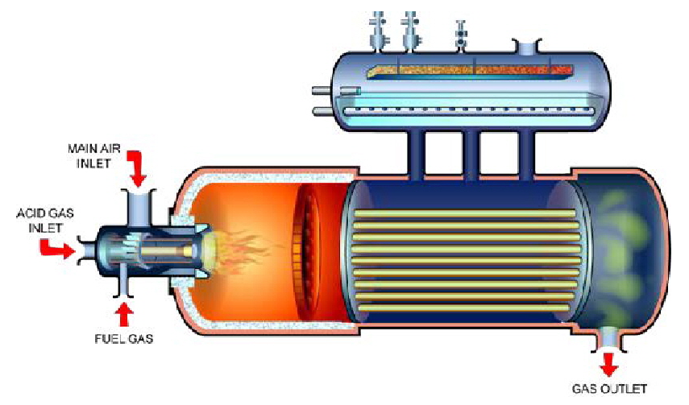
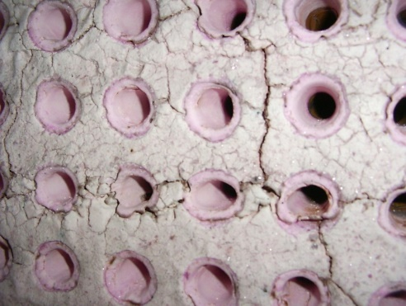
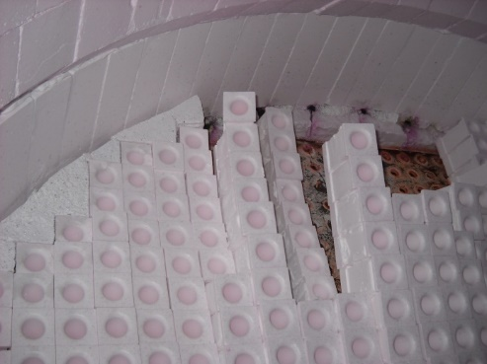
Challenges for successfully shutdown
CHALLENGES FOR SUCCESSFULLY SHUTDOWN:
When a design improvement make more relaxing STO execution
CASE STUDY 1. Revamping on WHB in a sulfur recovery unit
Refractory degradation on WHB tube-sheet

Slide 20
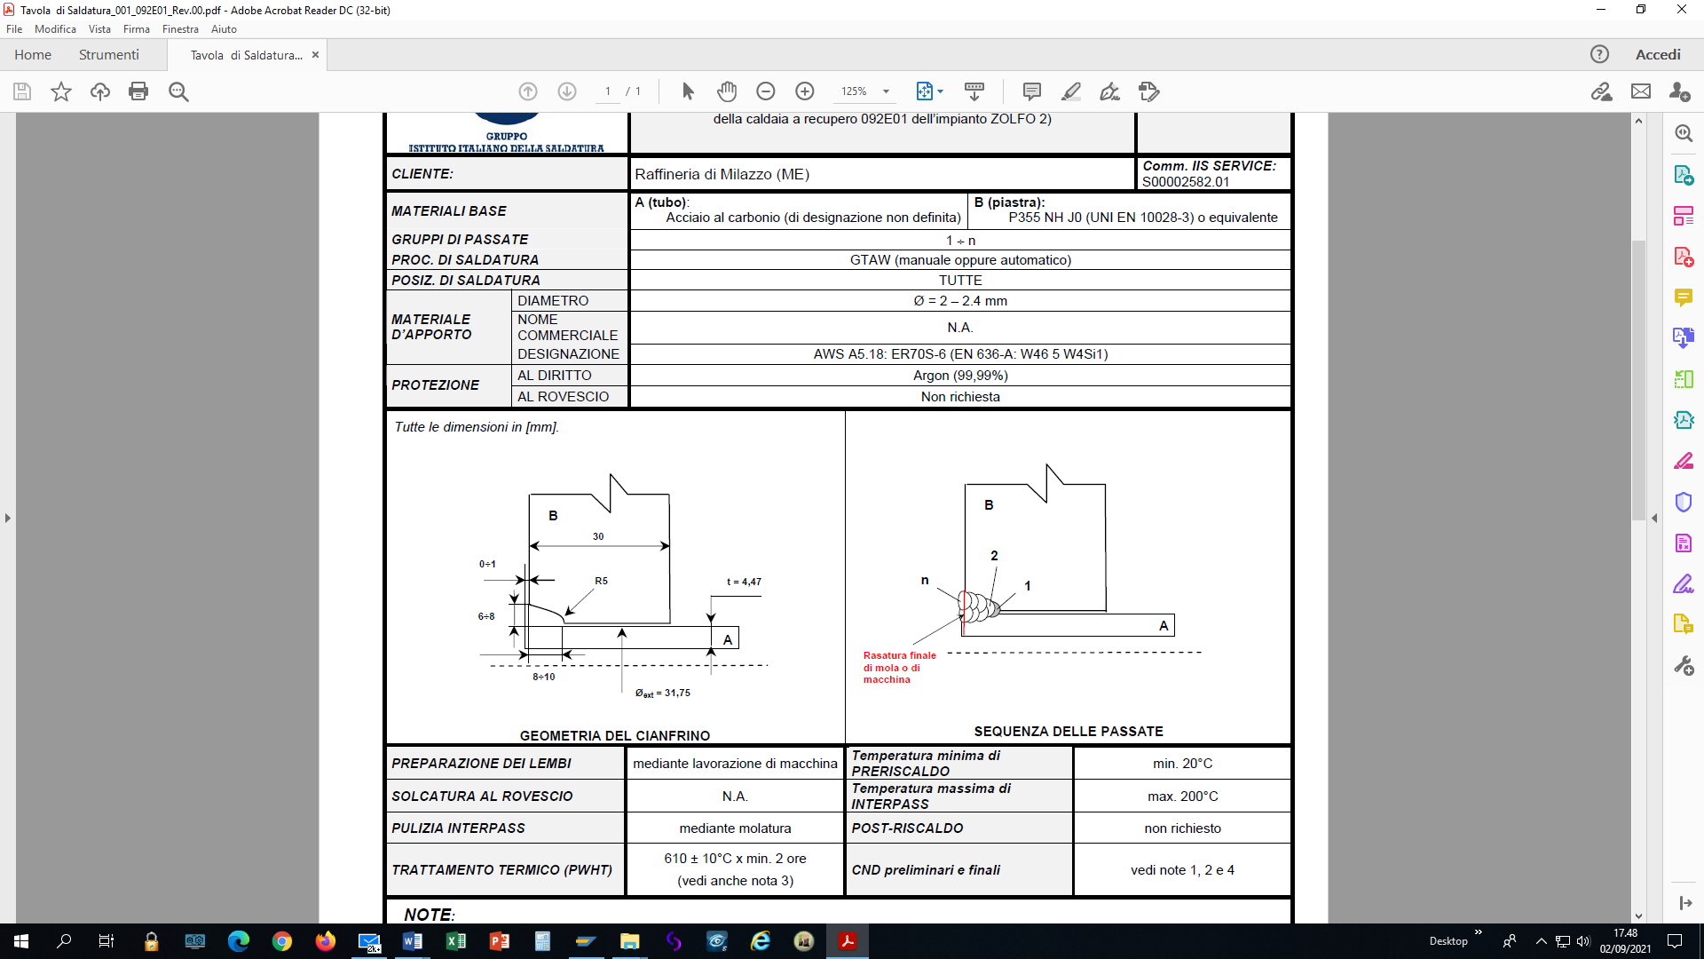
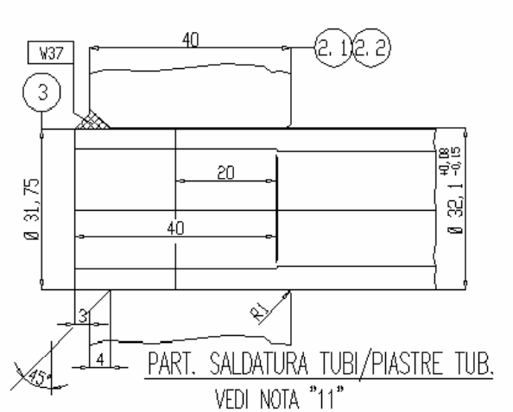
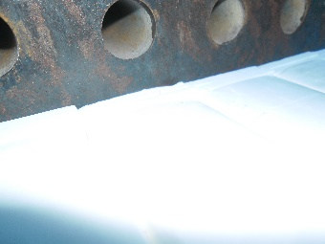
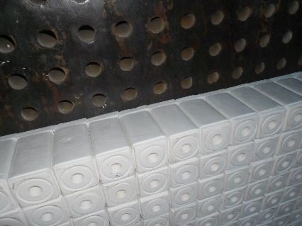
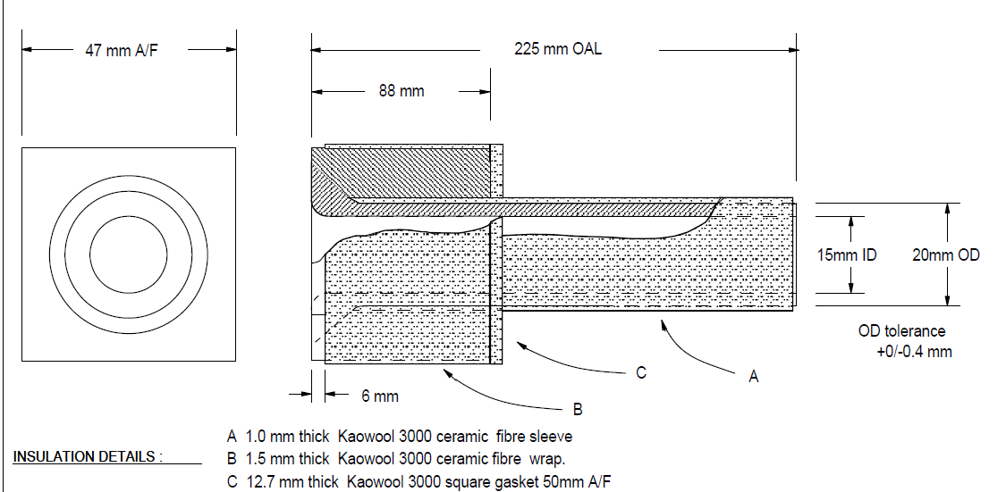
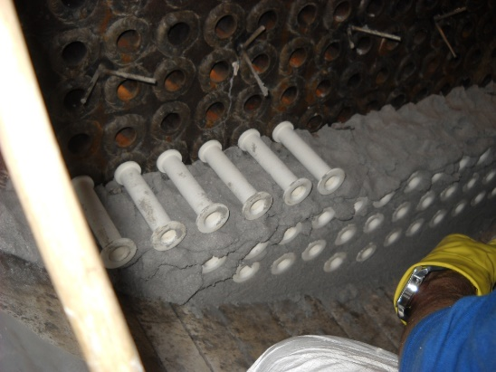
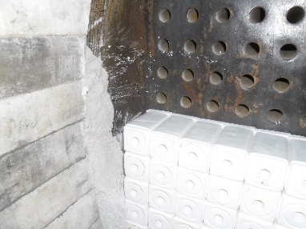
Challenges for successfully shutdown-improvement reliability
CASE STUDY 1- WHB of SRU unit revamping
Mechanical improvements on welding joint tubes/Tube sheet
Modified configuration, allowing a more efficient heat transmission avoiding damage on tube sheet
Original configuration
Refractory shield modification, up-graded to special “two peace” ferrule square heads.
Original configuration
Modified configuration

Slide 21
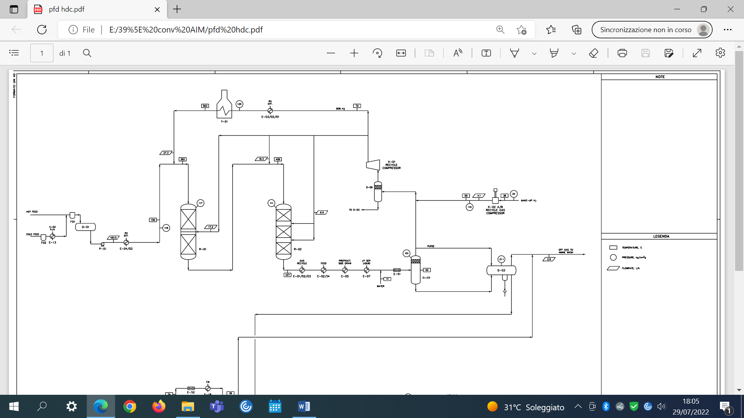
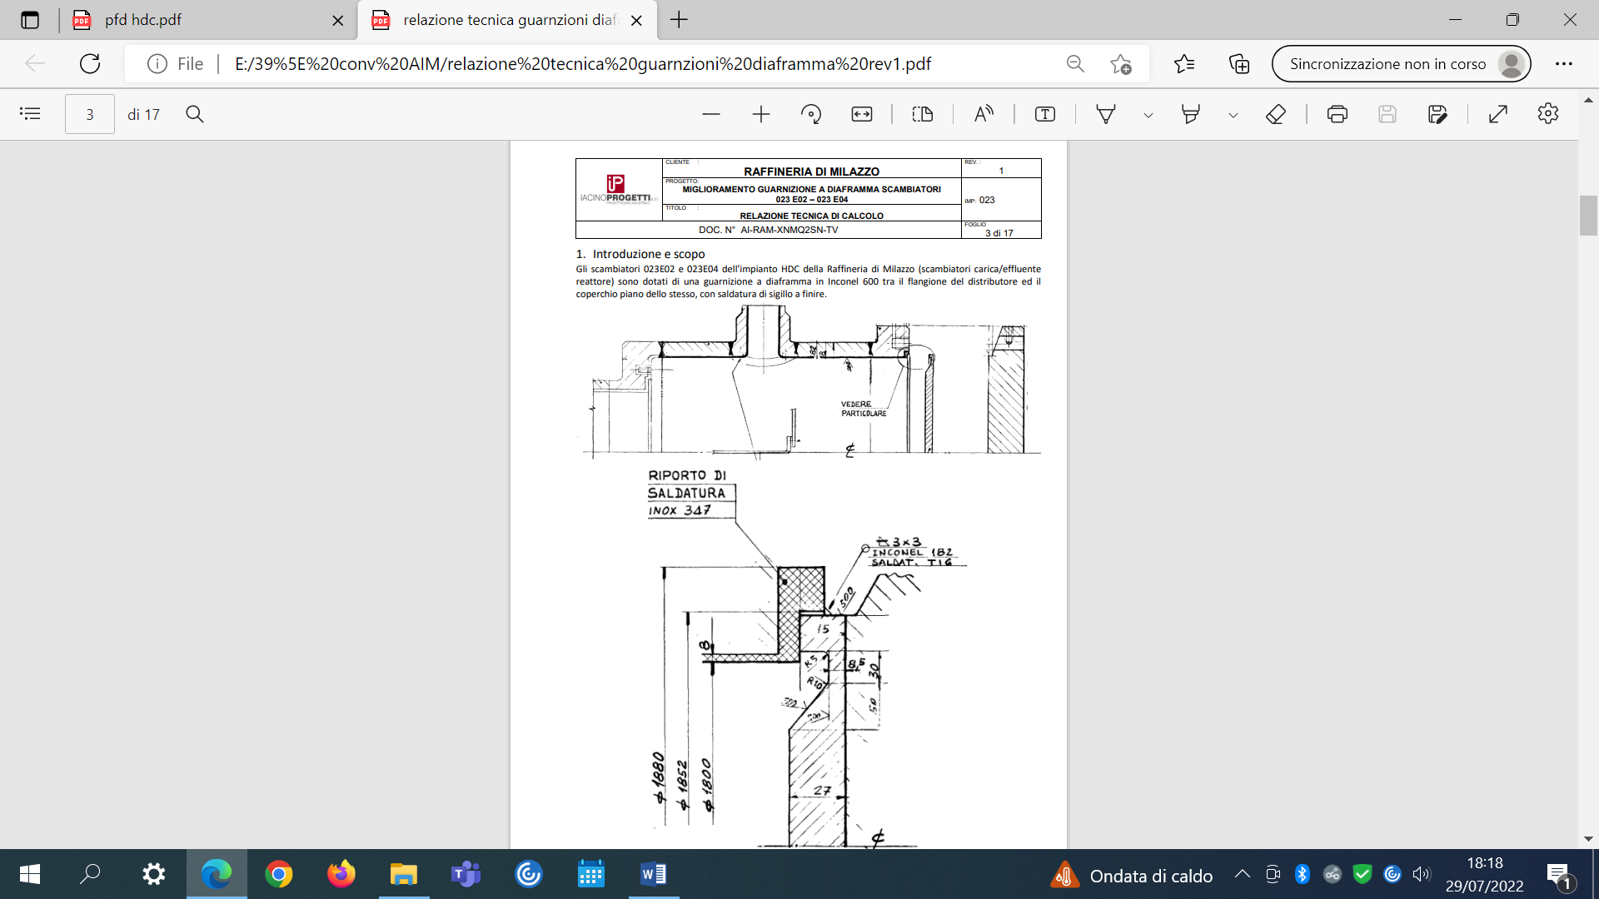
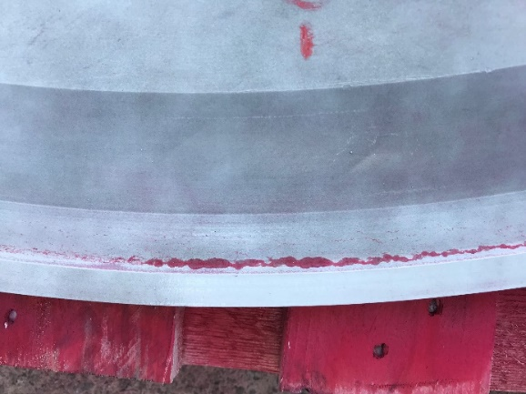
Challenges for successfully shutdown-improvement reliability
CASE STUDY 2- diaphragm gasket of high pressure exchangers (HDC unit)
Mechanical improvements to reduce stress concentration preventing Polityonic-SCC
Material nickel alloy 600
Original configuration
PSCC finding from LP on feed-reactor effluent diaphragm gasket exchanger
Original configuration
Modified configuration

Slide 22
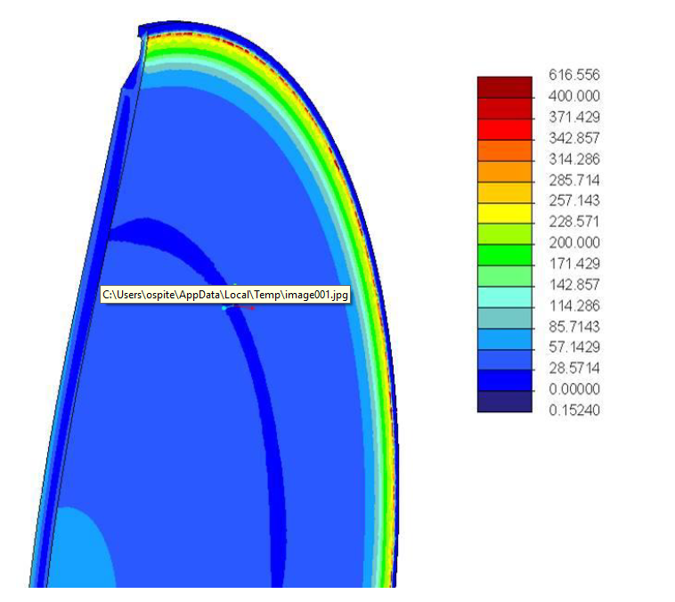
Challenges for successfully shutdown-improvement reliability
CASE STUDY 2- diaphragm gasket of high pressure exchangers (HDC unit)
Stress Analysis, FEM assessment: normal operation and start-up/shut down behavior
Original configuration
Modified configuration: less stress to the notch means less PSCC risk
Also a metallurgical up-grade as been carried out from Alloy 600 up to Alloy 625, less susceptible for PSCC mechanism, with particular attention to delivery conditions (grain size)

Slide 23

Thank your for your attention
Giuseppe Chiofalo, Senior Maintenance Engineer - Milazzo Refinery, ITALY
Giuseppe.chiofalo@ram.it
Material engineer, PhD in Materials engineering and industrial chemistry

